Slide 1
Beer and Brewery
Tadd Backus & Austin Webb
June 14, 2022

Slide 2
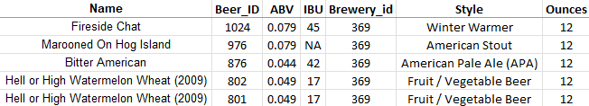
What is the Data?
Beer Dataset:
2,410 rows and 7 columns
Name: Name of the beer
Beer_ID: Unique identifier of the beer
ABV: Alcohol by volume of the beer
IBU: International bitterness units of the beer
Brewery_ID: Brewery id associated with the beer
Style: Style of the beer
Ounces: Ounces of beer

Slide 3
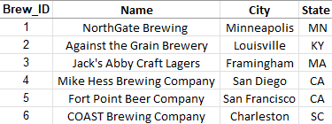
What is the Data?
Brewery Dataset:
558 rows and 4 columns
Brew_id: Unique identifiers of the brewery
Name: Name of the brewery
City: City where the brewery is located
State: U.S. state where the brewery is located

Slide 4
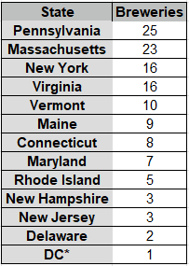
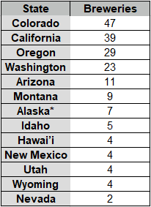
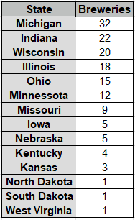
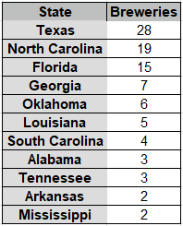
How Many Breweries in Each State

Slide 5
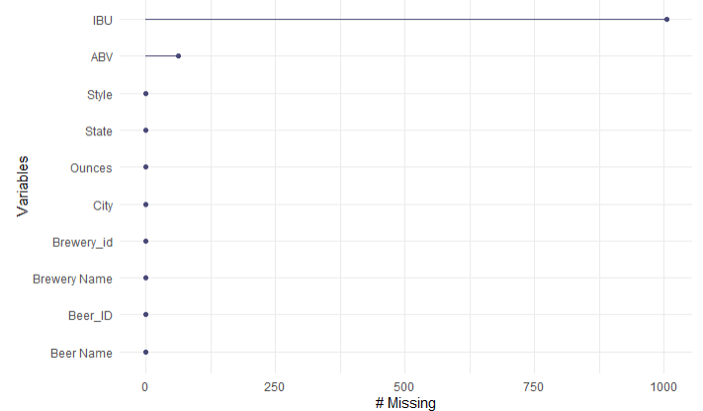
Address the Missing Values
ABV has 62 missing values (2.57%)
IBU has 1005 missing values (41.70%)
Used a statistical procedure called kNN to impute the data

Slide 6
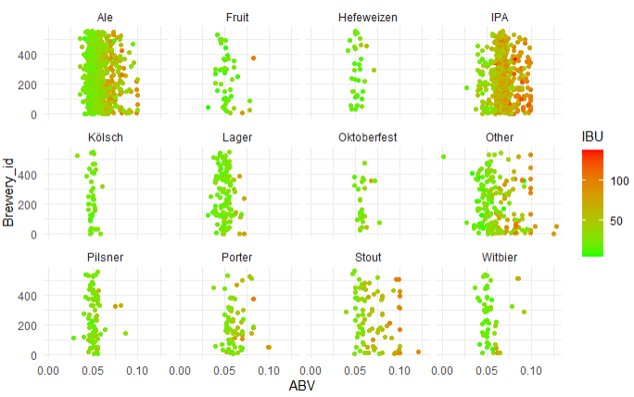
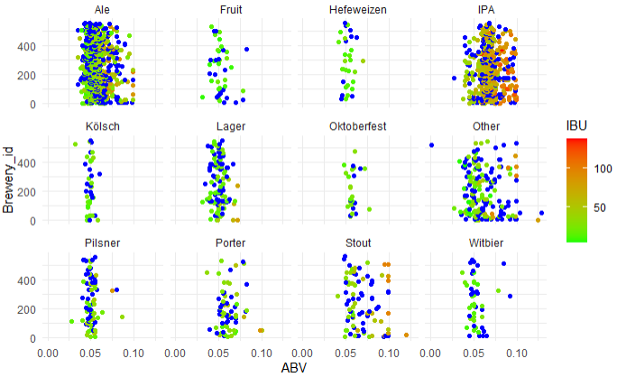
Deal With the Missing ABV and IBU Values
Grouped the beers into 12 types based on their name
Imputed the missing values with five closest beers of the same type

Slide 7
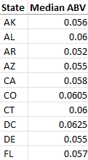
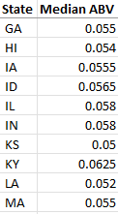
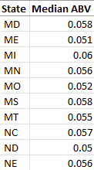
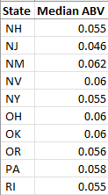
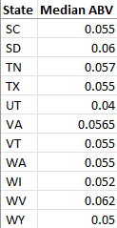
Median ABV for Each State
We can see the median ABV for each state

Slide 8
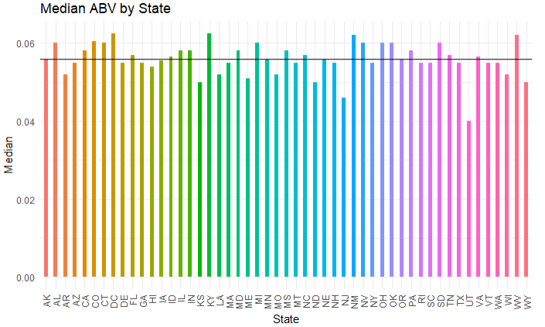
Median ABV for Each State
We can visually see how each state’s median ABV compares to each other
Horizontal line is the mean (0.05588)

Slide 9
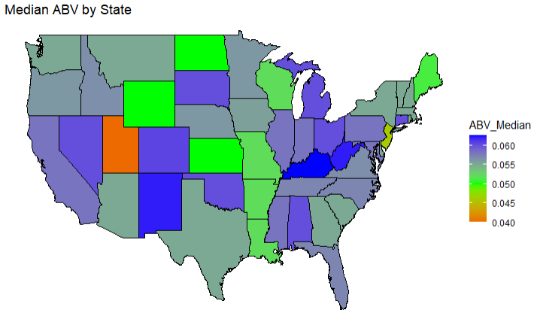
Median ABV for Each State
Utah is clearly the holder of the lowest median ABV at 0.04
Kentucky has the highest median ABV with 0.0625

Slide 10
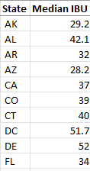
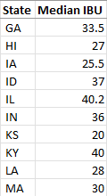
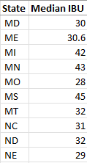
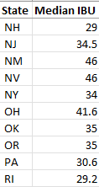
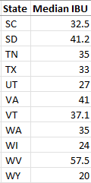
Median IBU for Each State
We can see the median IBU for each state

Slide 11
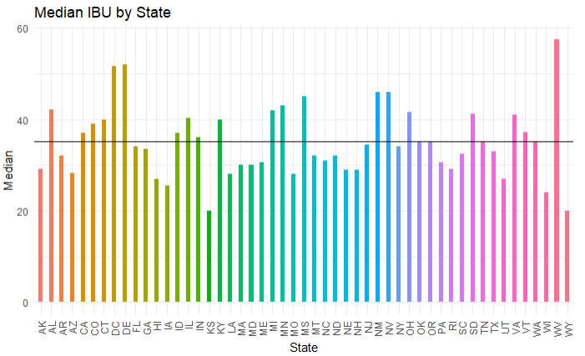
Median IBU for Each State
We can visually see how each state’s median IBU compares to each other
Horizontal line is the mean (35.082)

Slide 12
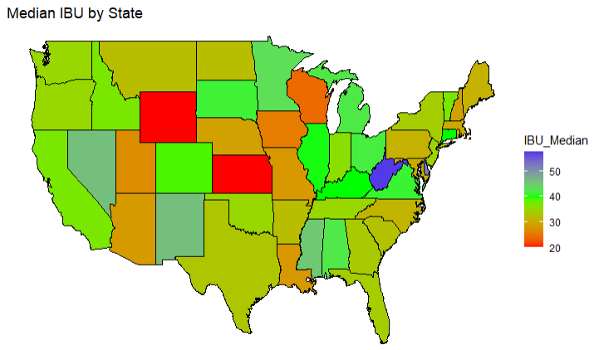
Median IBU for Each State
Wyoming and Kansas are tied for the lowest median IBU with 20
The highest median IBU is West Virginia with 57.5

Slide 13
Max ABV
We searched the database and extracted this row
Max ABV is found in Boulder, Colorado
Max ABV is 0.128
This beer is classified as an Ale

Slide 14
Max IBU
We searched the database and extracted this row
Max IBU is found in Astoria, Oregon
Max IBU is 138
This beer is classified as an IPA

Slide 15
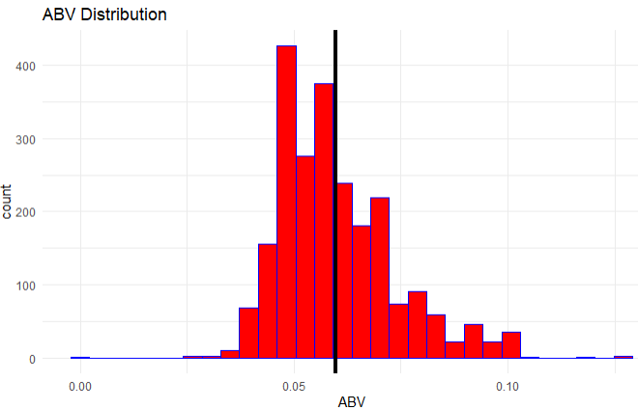
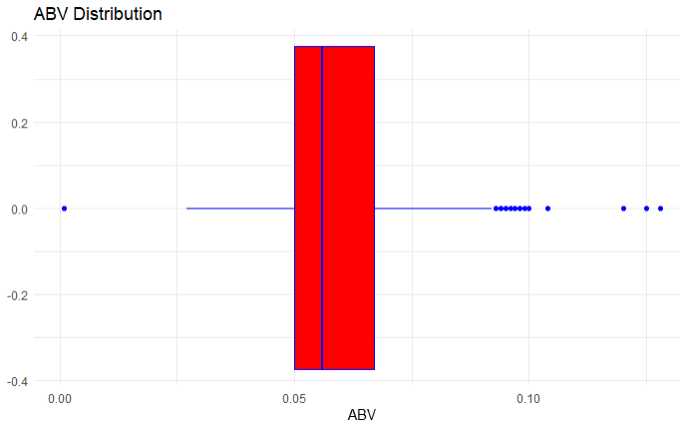
ABV Statistics
Minimum: 0.001
1st Quarter: 0.05
Median: 0.056
Mean: 0.05976
3rd Quarter: 0.067
Max: 0.128

Slide 16
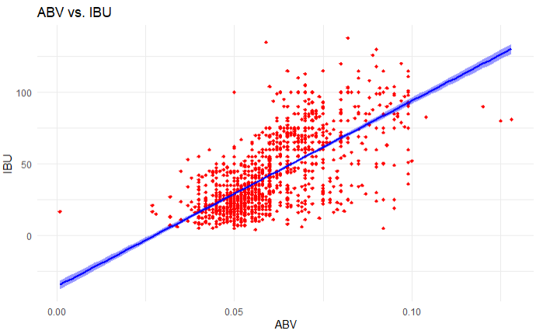
Relationship Between ABV and IBU
The correlation coefficient is 0.7222
This suggests that the average IBU will increase by 0.7222 units for every one unit of increase in ABV

Slide 17
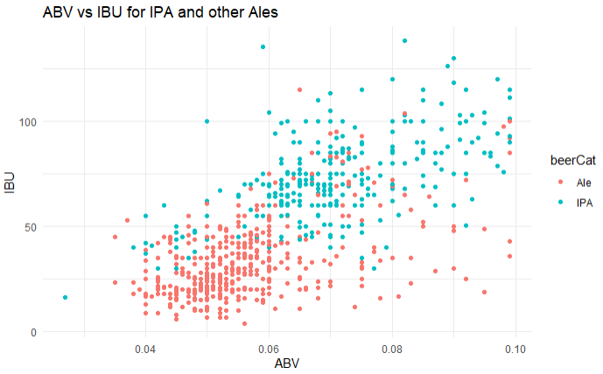
Relationship Between IPA and Other Ales
Ales tend to have a lower ABV & IBU
IPAs tend to have a higher ABV & IBU

Slide 18
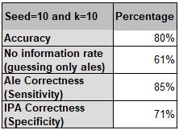
Classifying Ales and IPAs Based on ABV and IBU
The classifier predicted correctly 80% of the time
This performed almost 20% better than saying everything was an Ale
Ales were correctly classified 85% of the time
IPAs were correctly classified 71% of the time

Slide 19
Classifying Ales and IPAs Based on ABV and IBU
Sensitivity
Accuracy
Specificity
The solid line represents the mean results for each value of K over 500 iterations of splitting the ales and IPAs.
The dashed line represents the results for each value of K from a single split of the ales and IPAs
The point represents the results for a single value of K (11) from a single split of the ales and IPAS

Slide 20
Popular Beer Types by State
Each bar represents the total number of beers for each state, colored by how many of each type there are.
Ales, IPAs, and Lagers represent a significant portion of each state’s beer types.

Slide 21
Popular Beer Types by State
Ales are the most common beer at breweries in 42 states.
IPAs are the second most common beer at breweries in 4 states.

Slide 22
Summary and Conclusion
Breweries are scattered around the US
Max ABV: 0.128, Colorado, Ale
Max IBU: 138, Oregon, IPA
There is a positive, linear trend between ABV and IBU
Lots more Ales as most common beer type across the US

Slide 23
Contact Info
Tadd Backus
tbackus@mail.smu.edu
Austin Webb
austinwebb@mail.smu.edu

